Slide 1
Farmers’ Market
Vending 101
Debra Bolding
Co-Manager, Howard County Farmers’ Market
Miller County Master Gardener

Slide 2
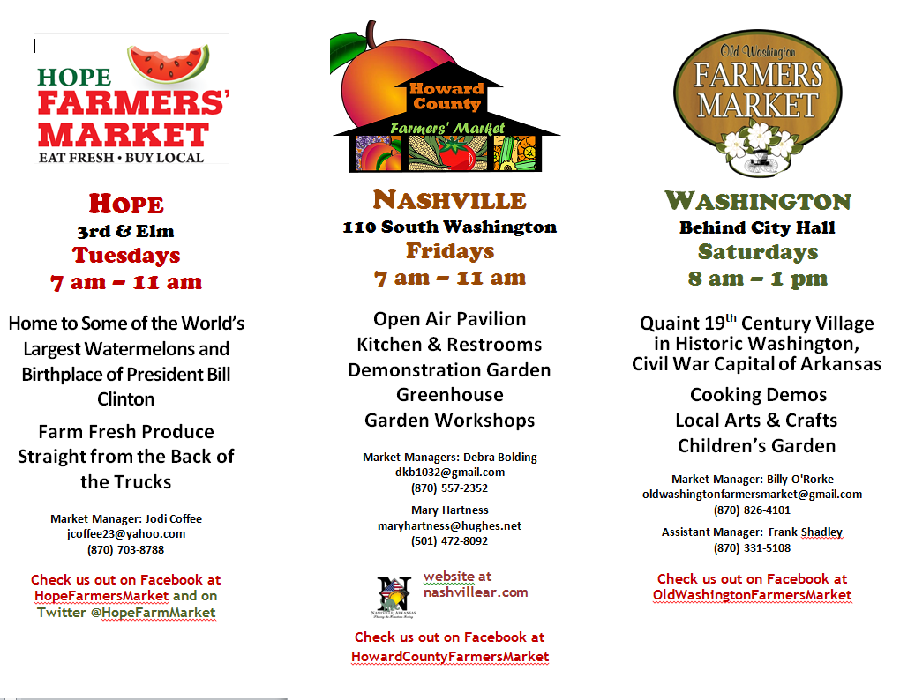
Notes:
Quickly Reference these local markets and explain that they compose the Southwest Farmers’ Market Consortium.
Let them know the handouts in the blue Farmer’s Market Vendor packets include the registration forms for these markets and materials for you to reference during the presentation.

Slide 3
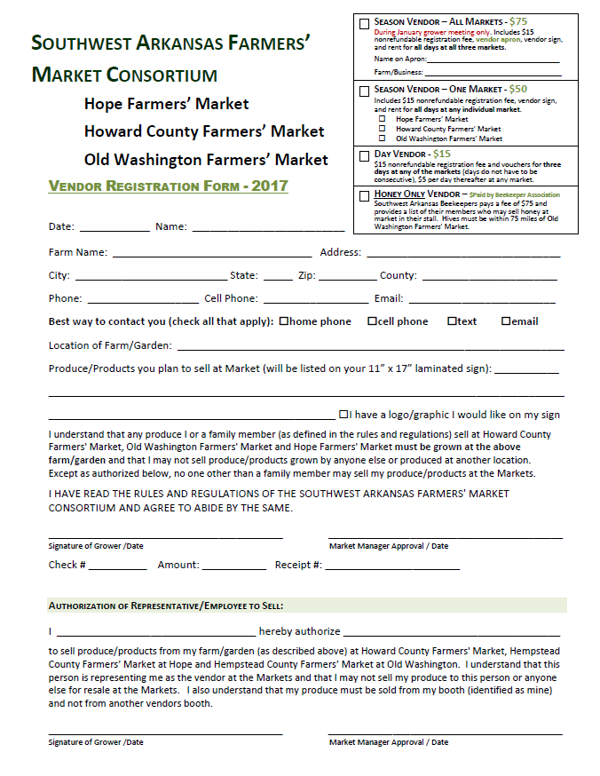
$75 for three markets
during annual meeting
(That’s Now!)
Notes:
Briefly mention the TODAY ONLY incentives for those considering selling this year at those three markets - lower fee plus FREE APRON.

Slide 4
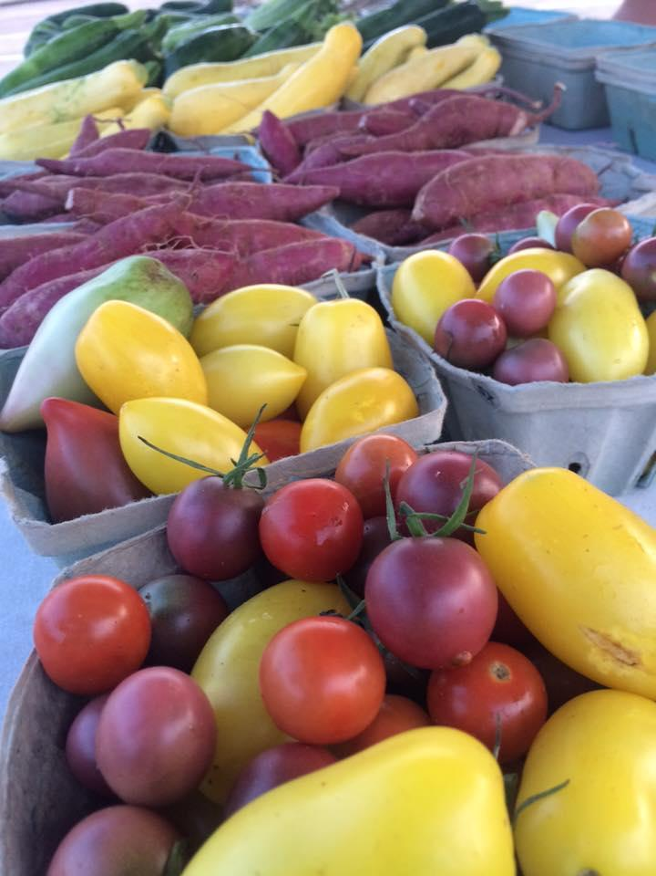
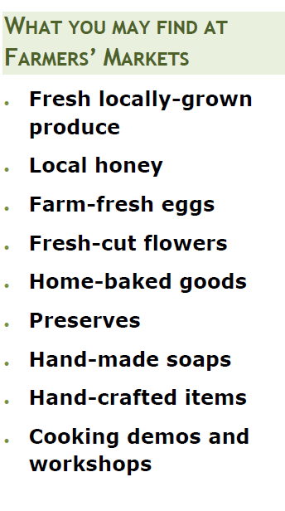
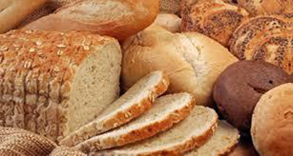

Slide 5
Raw Fresh Fruits and Vegetables
Whole
Uncut
Notes:
UNCUT IS IMPORTANT FOR NEWBIES

Slide 6
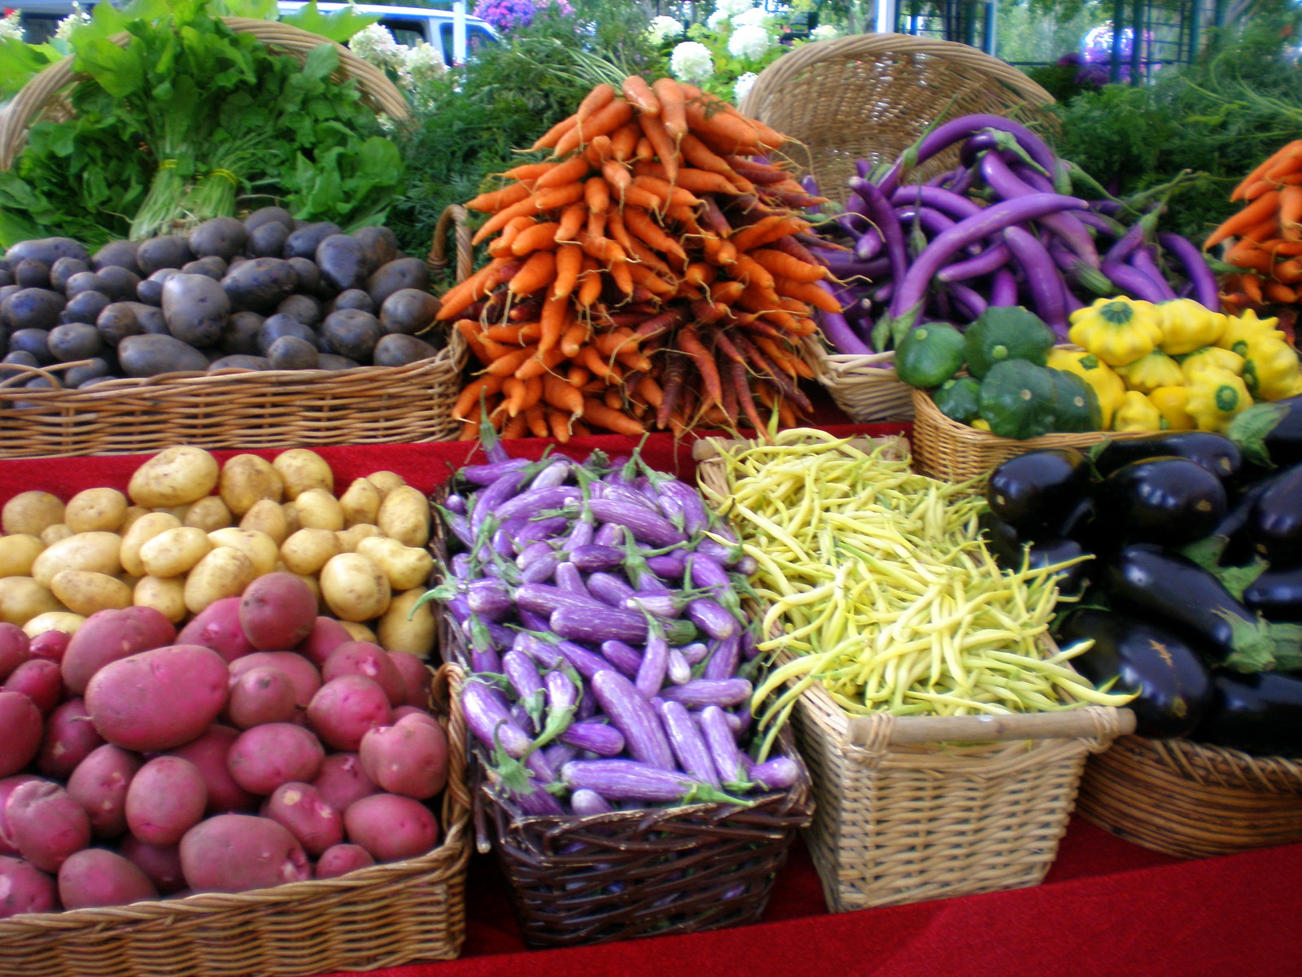
Notes:
These are very quickie visuals for fresh produce . . . Whole and uncut . . . Note quality & abundance . . .

Slide 7
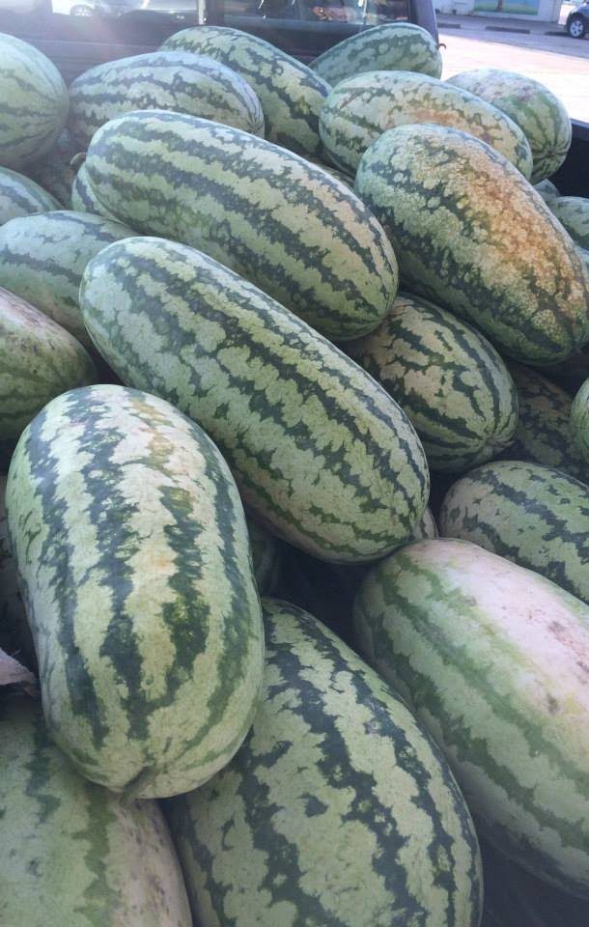
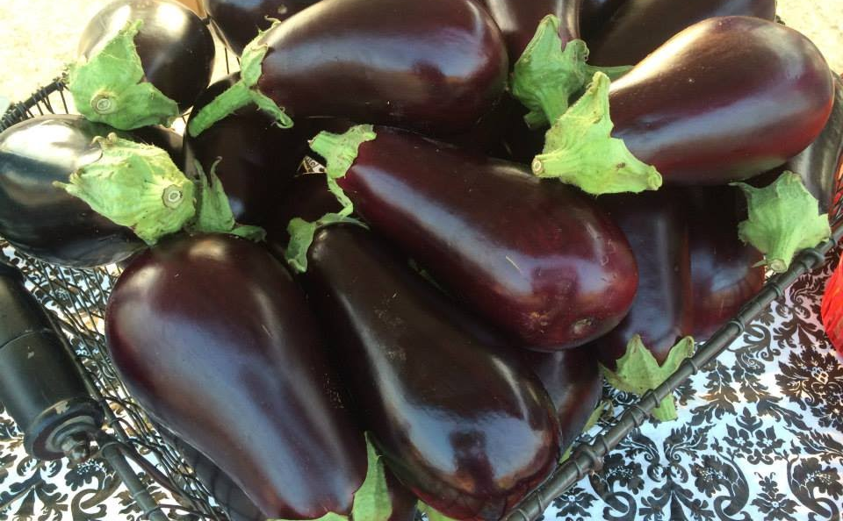
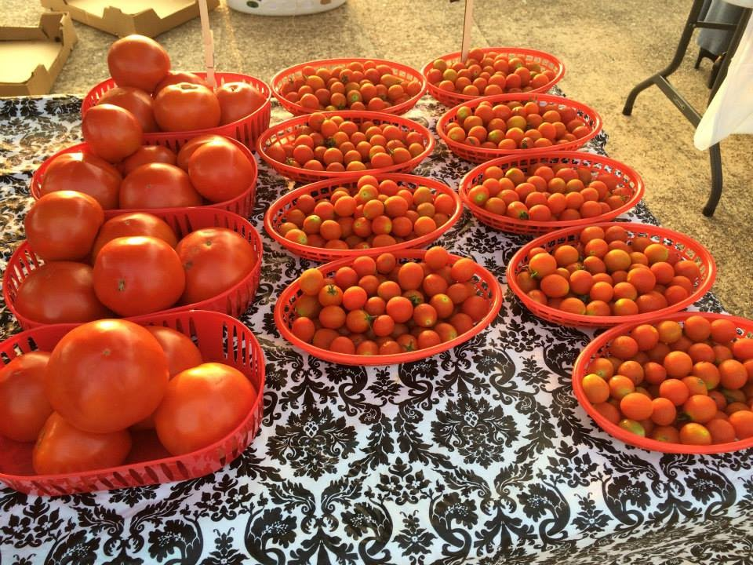
Notes:
More quickie visuals for fresh produce . . . Whole and uncut . . . Note quality & abundance . . .

Slide 8
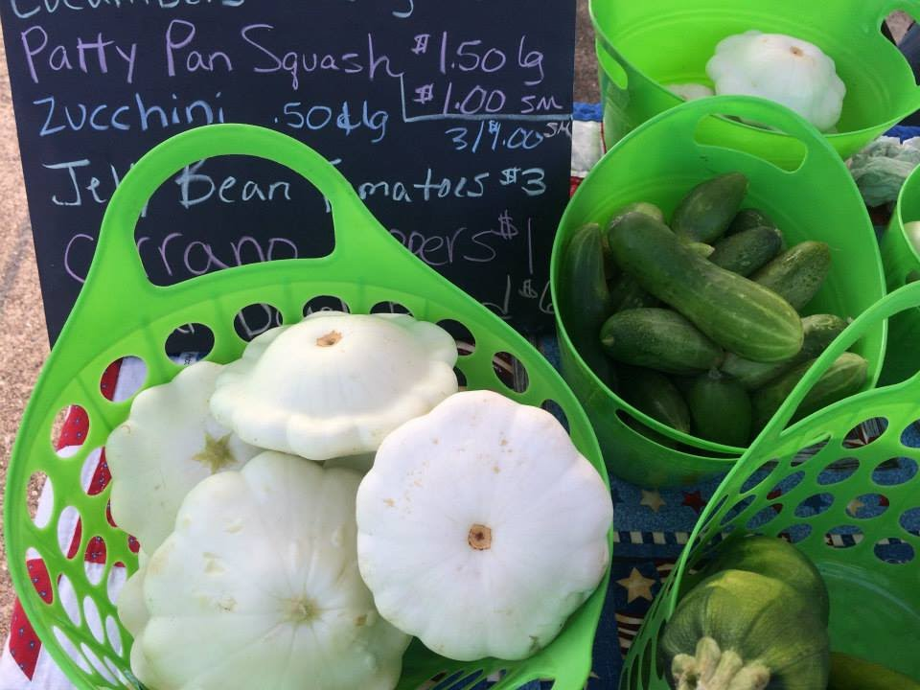
Notes:
More quickie visuals for fresh produce . . . Whole and uncut . . .

Slide 9
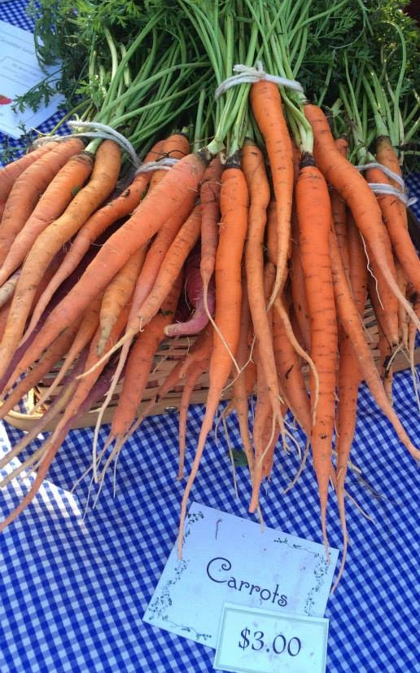
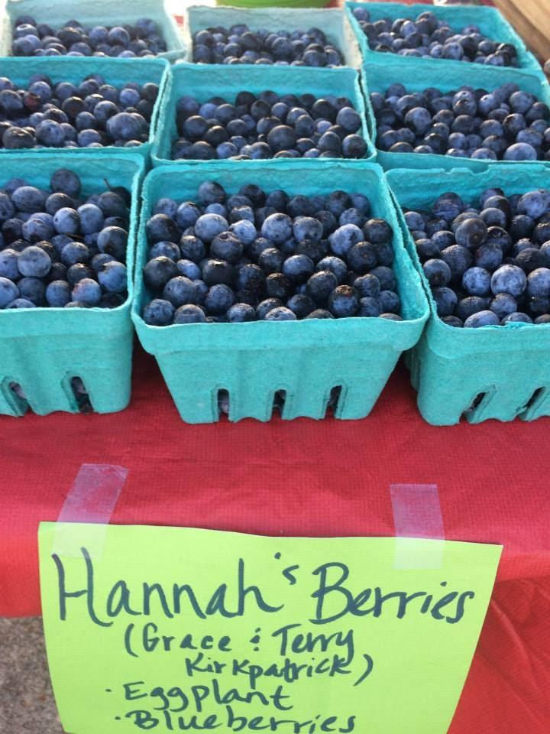
Notes:
And more of same . . . Fresh, whole, uncut . . .

Slide 10
Fresh Cut Flowers

Slide 11
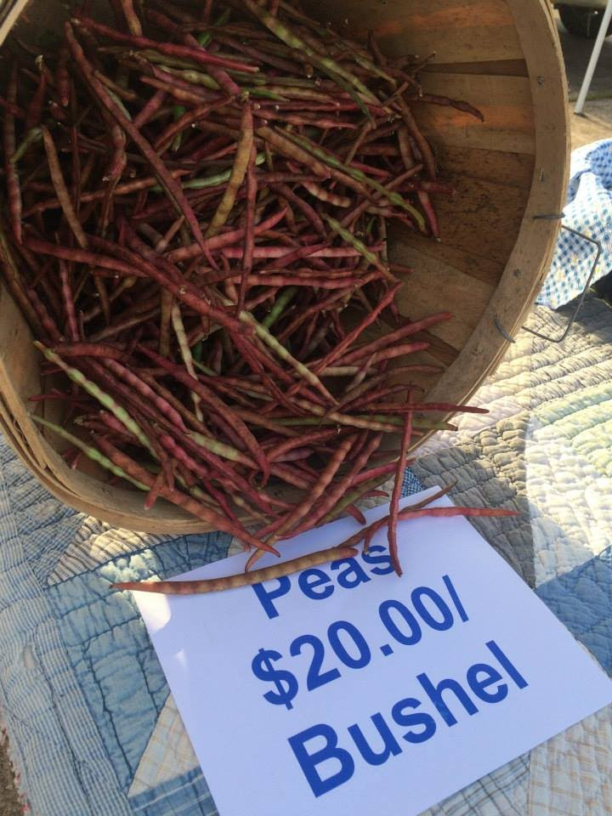
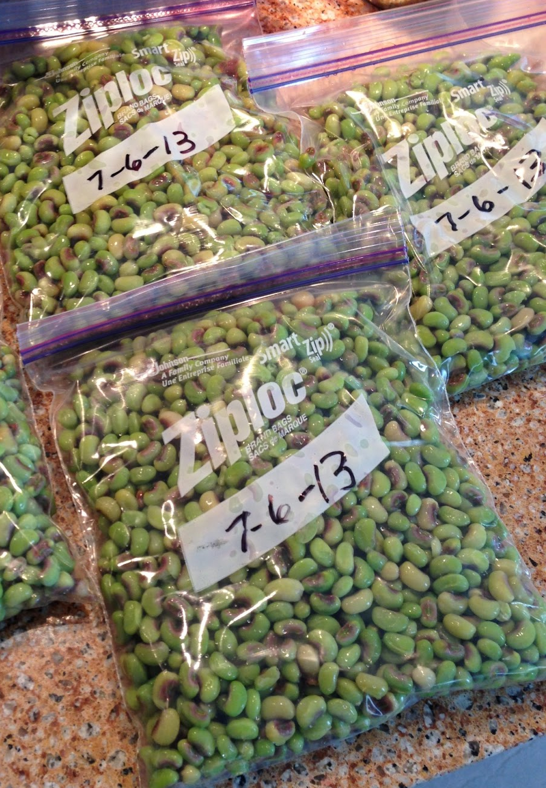
This Not This
Notes:
THIS IS IMPORTANT . . . WE OFTEN SEE THIS UNACCEPTABLE PACKAGING WITH INEXPERIENCED GROWERS

Slide 12
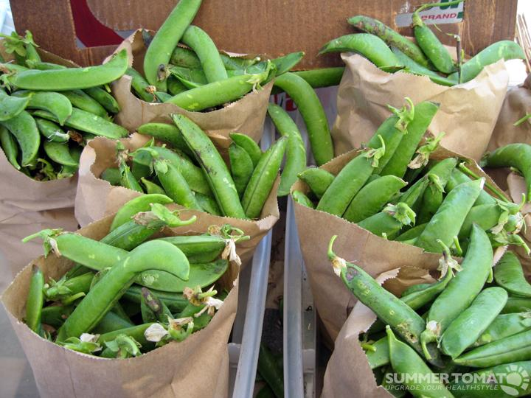
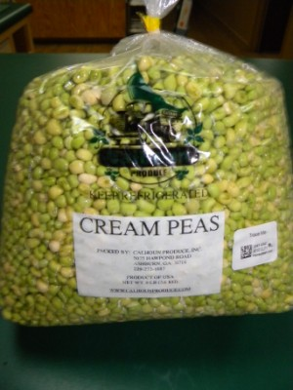
This Not This
Notes:
THIS IS IMPORTANT . . . MORE ACCEPTABLE VS. UNACCEPTABLE PACKAGING . . .

Slide 13
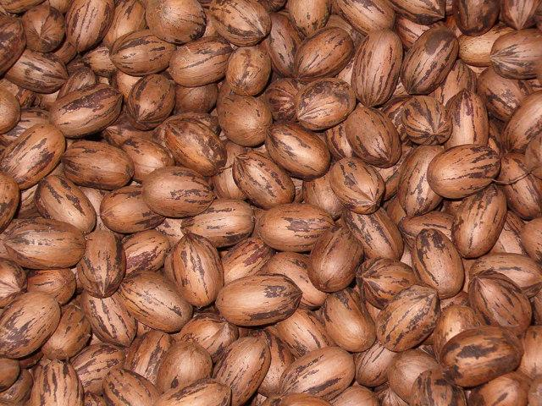
This Not This
Notes:
THIS IS IMPORTANT . . . MORE ACCEPTABLE VS. UNACCEPTABLE PACKAGING . . .

Slide 14
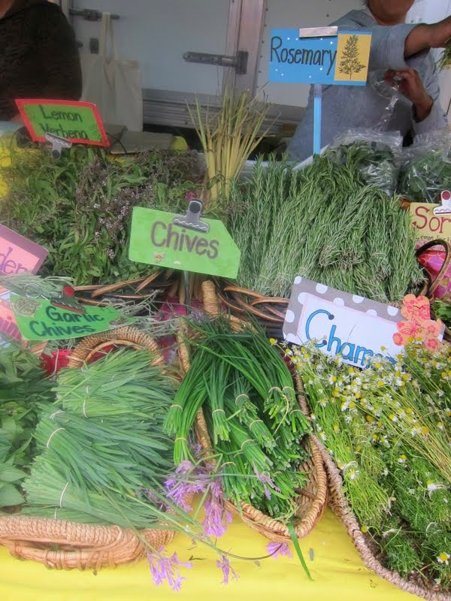
This Not This
Notes:
THIS IS IMPORTANT . . . FRESH VS. UNACCEPTABLE DRIED HERBS . . .

Slide 15
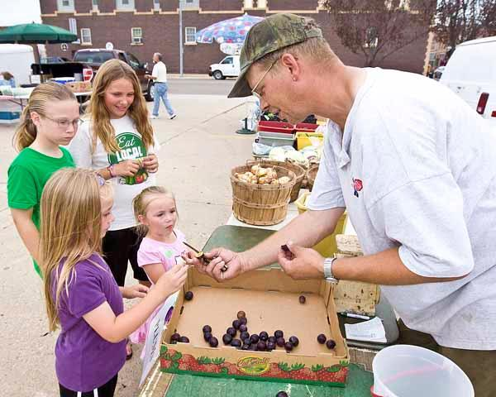
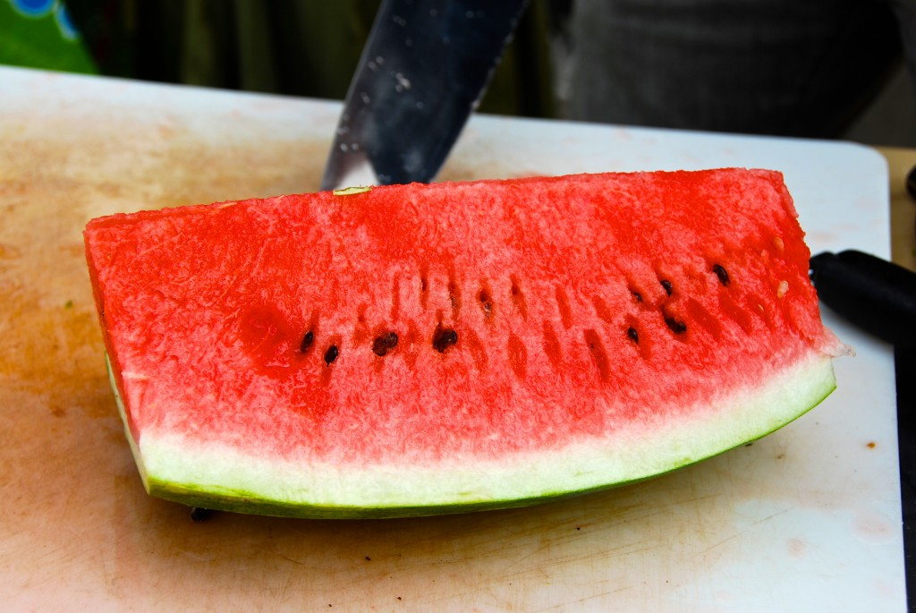
NO sliced produce, including samples
Notes:
NOT ACCEPTABLE!!!!

Slide 16
NO juices
Notes:
NOT ACCEPTABLE

Slide 17
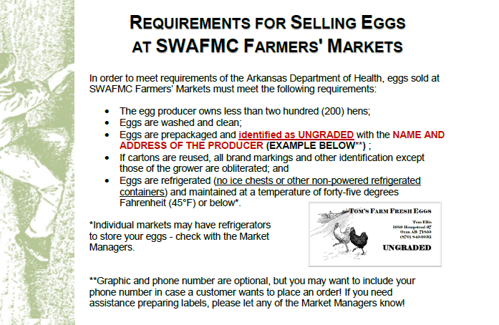
Fresh Eggs
Notes:
This handout is part of the FM 101 packet – summarizes what will be covered in next few slides on selling eggs.

Slide 18
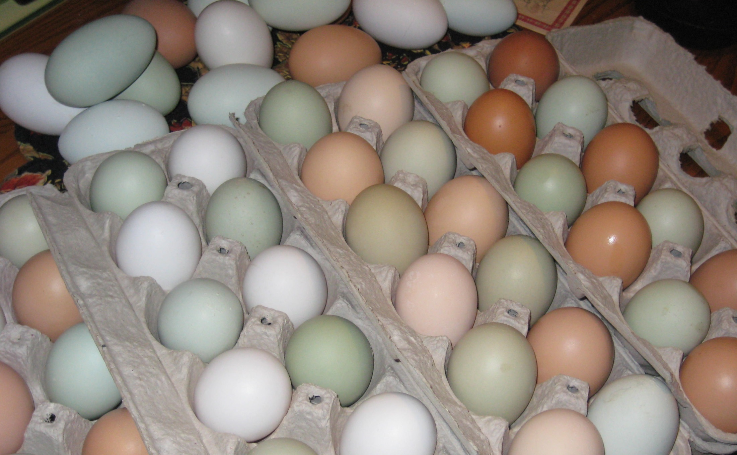
Fresh Eggs

Slide 19
Fresh Eggs
Regulations set by the Arkansas Livestock and Poultry Commission.
Notes:
Regulations not set by Markets, but by AR Livestock and Poultry Commission . . . Apply statewide . . .

Slide 20
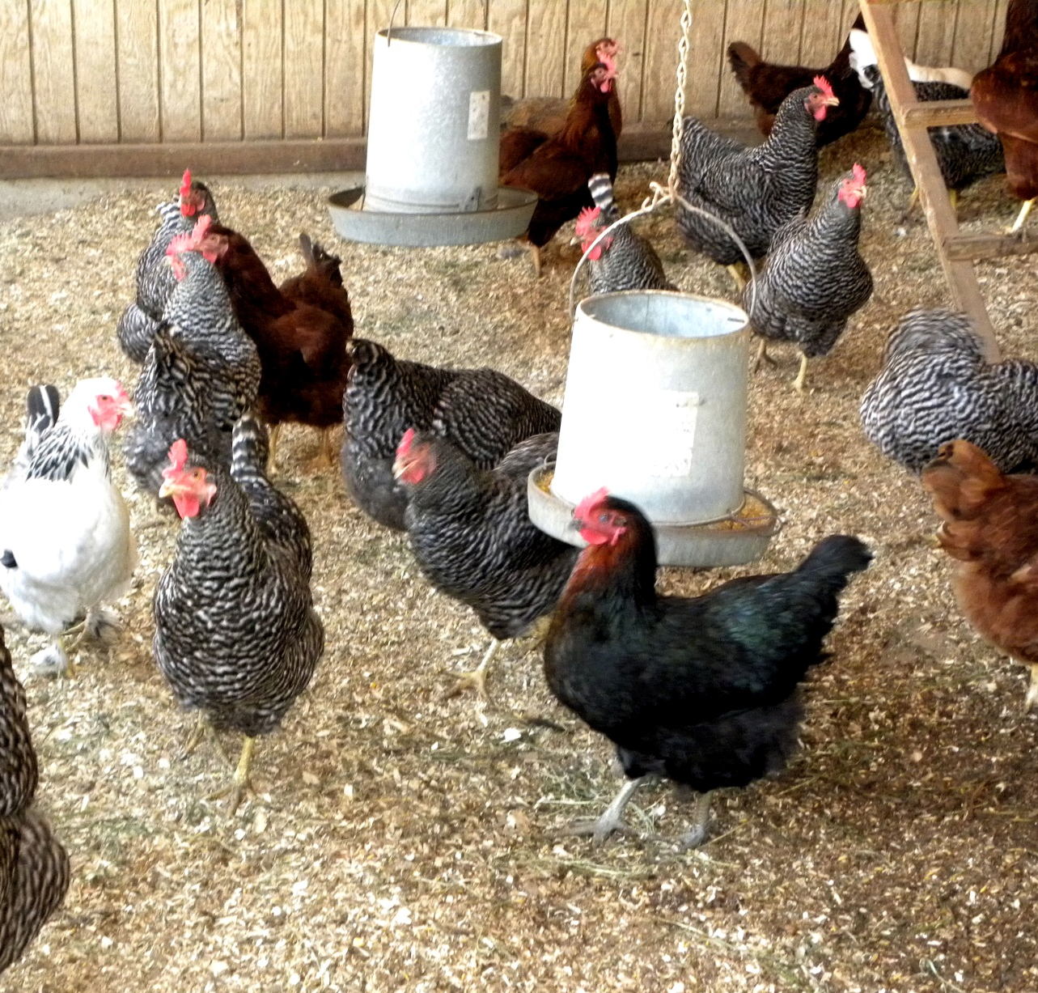
Fresh Eggs
Own less than two hundred (200) hens

Slide 21
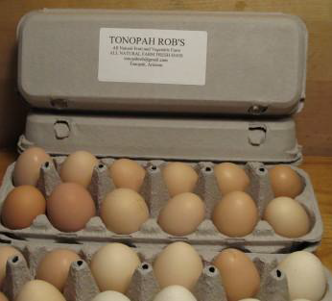
Fresh Eggs
Prepackaged, washed and clean
Marked “ungraded”
Name and address
Notes:
“Ungraded”, name and address required.
Phone optional, but good idea for contacts . . . Even email or website would be good idea if grower has . . .

Slide 22
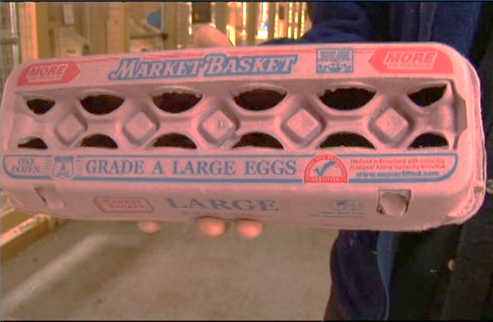
Fresh Eggs
No used cartons unless all brand markings and other identification is obliterated

Slide 23
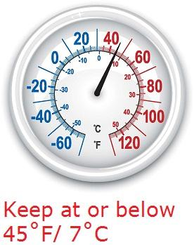
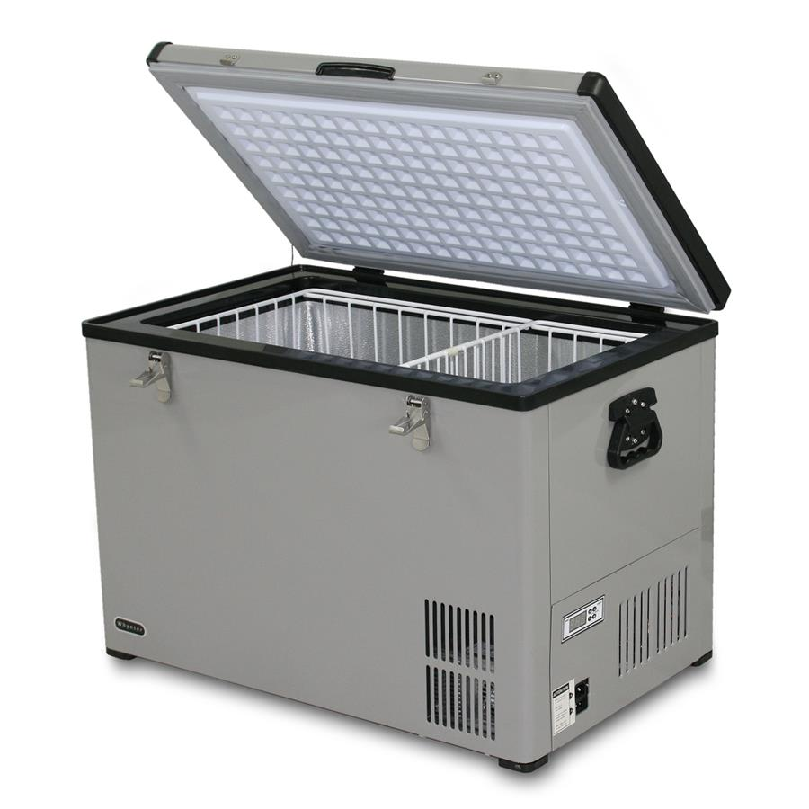
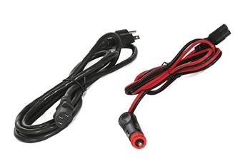
Fresh Eggs
Refrigerated
No ice chests
Temperature 45ºF or below (thermometer)

Slide 24
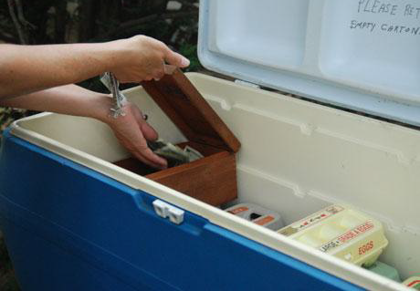
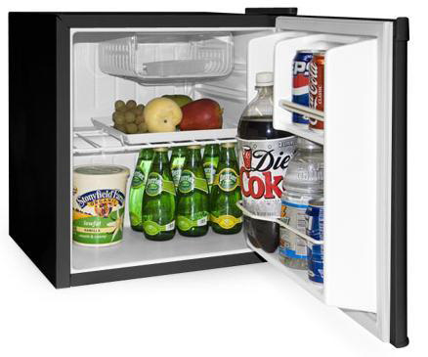
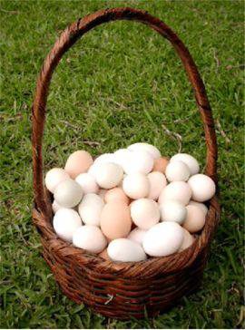
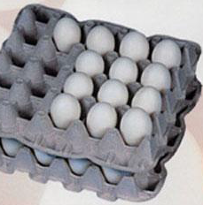
NOT Allowed Allowed

Slide 25
Honey
Labeled as “Honey” – No other ingredients
Name and address
Phone number

Slide 26
Sorghum Molasses
Can also sell sorghum molasses ! ! !

Slide 27
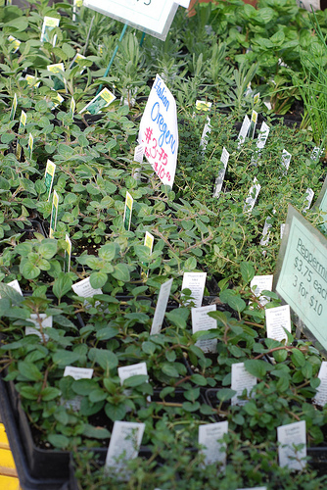
Potted Plants and Bedding Plants – Container plants that you grow yourself from seeds, cuttings or divisions and which are potted in soilless mix (no garden soil!).

Slide 28
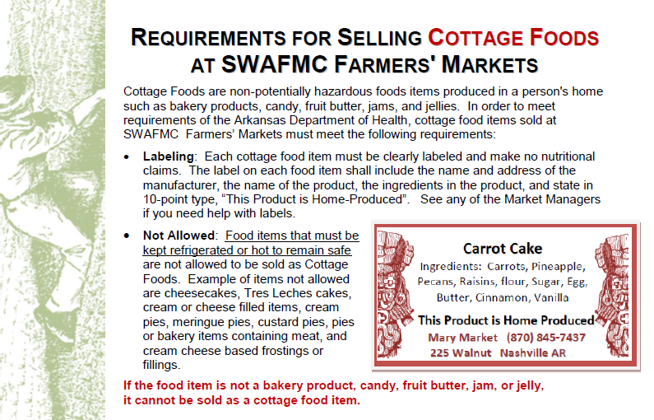
Notes:
This handout is part of the FM 101 packet – summarizes what will be covered in next few slides on cottage foods.

Slide 29
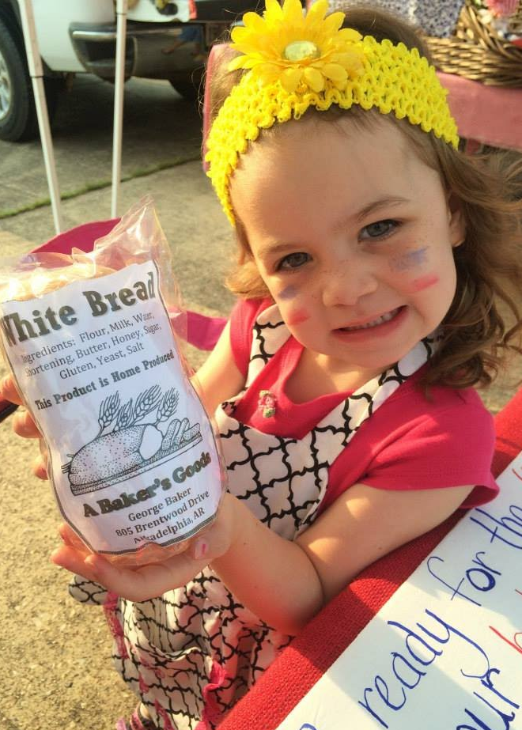
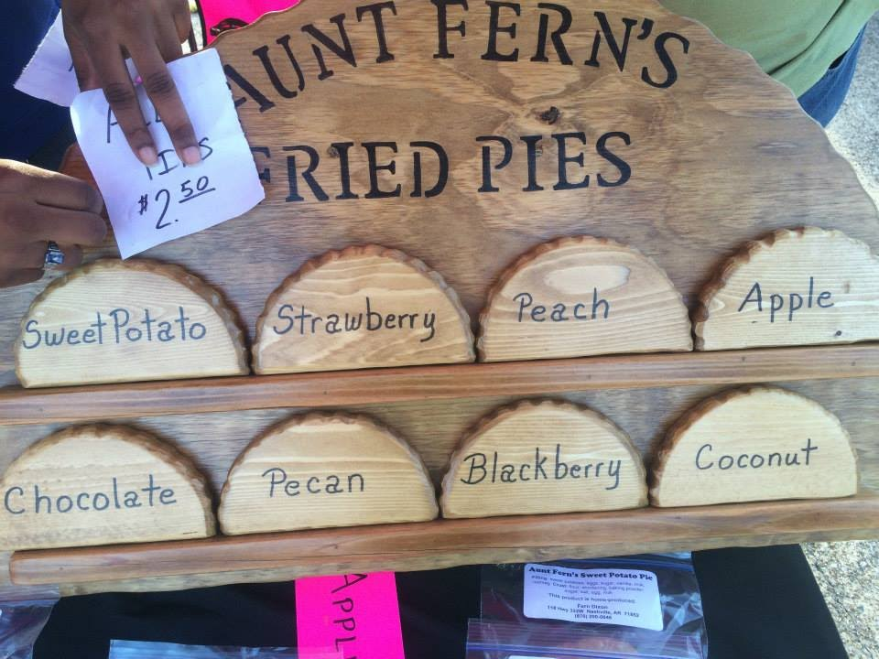
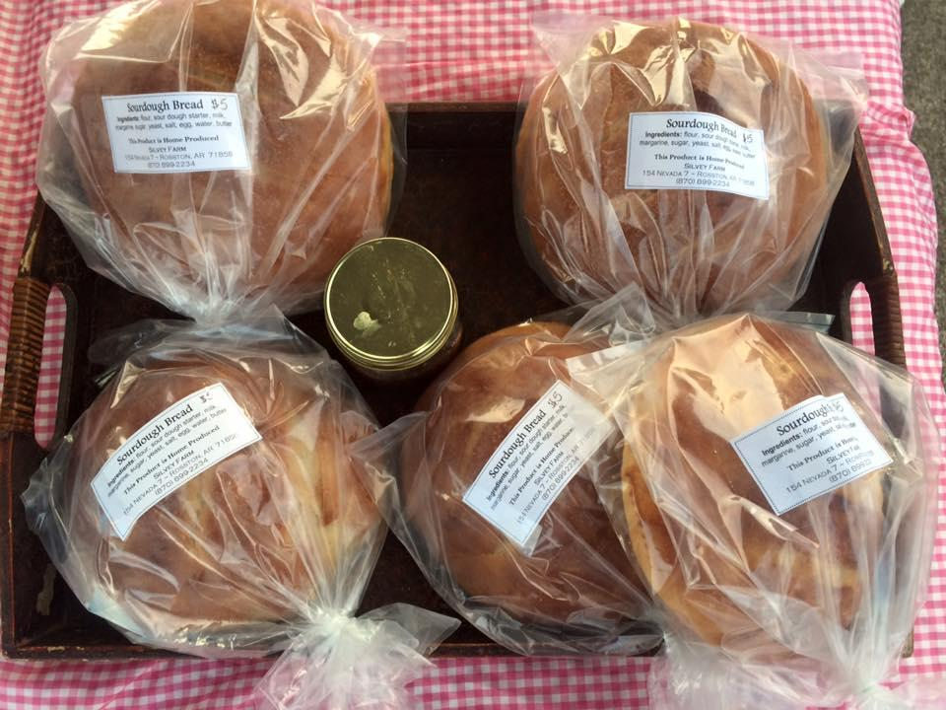
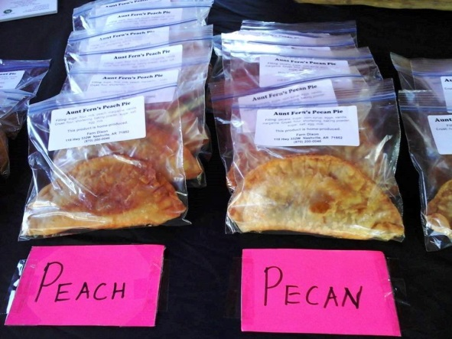
Cottage Foods

Slide 30
Cottage Foods
Food items produced in a person's home that are non-potentially hazardous
May only be sold direct from the manufacturer to the consumer either from the site where the food is made, a farmer’s market, a county fair, or a special event
Do not require a permit from the Arkansas Department of Health to be sold
ACT 72 of 2010

Slide 31
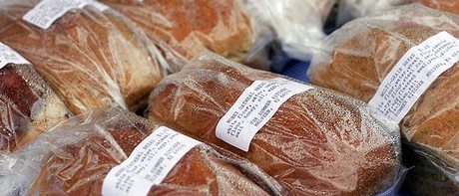
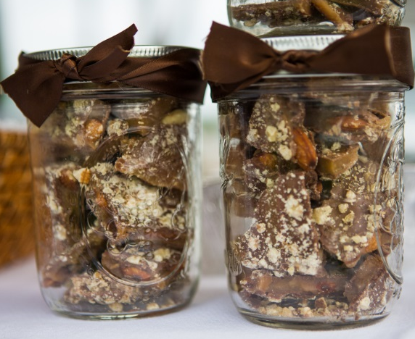
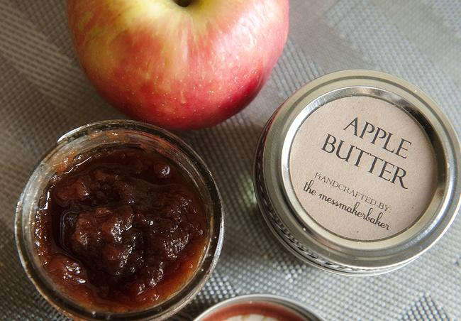
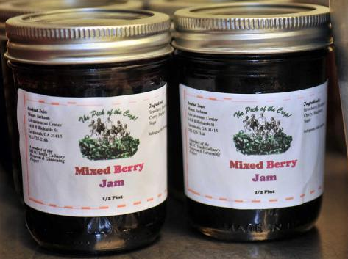
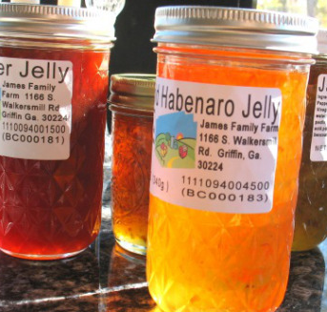
Cottage Foods
Baked goods
Candy
Fruit Butter
Jams
Jellies
Only thes above 5 products are covered in ACT 72 and are the only products allowed to be sold under ACT 72 of 2010.

Slide 32
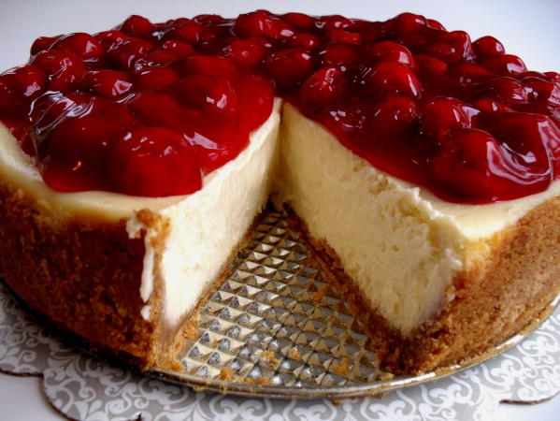
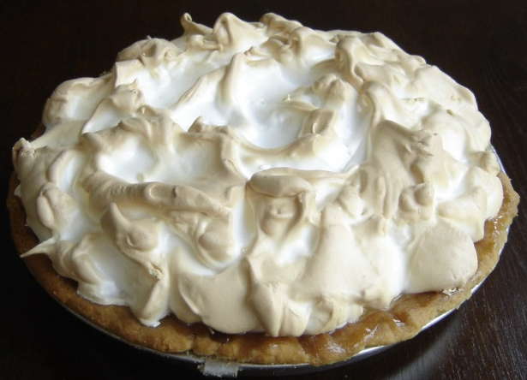
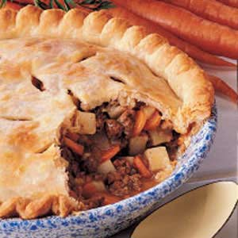
Cottage Foods
Does not have to be kept refrigerated or hot to remain safe . . .
NOT ALLOWED:
Cheesecakes
Tres leches cakes
Cream or cheese filled items
Cream pies
Meringue pies
Custard pies
Pies or bakery items containing meat
Cream cheese based frostings or fillings

Slide 33
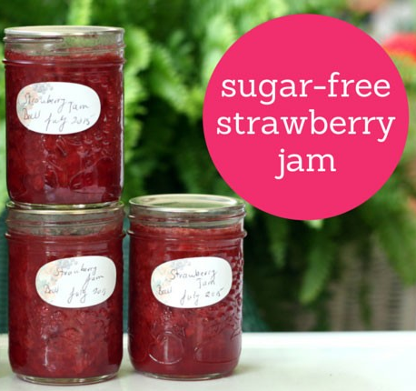
NO Sugar Substitutes in Jams, Jellies and Fruit Butters
Jams, jellies and fruit butter made with Splenda and similar sugar substitutes are considered potentially hazardous food and may not be sold.

Slide 34
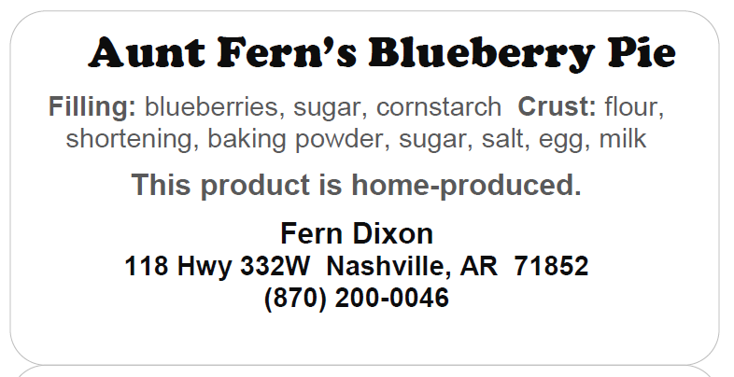
Cottage Foods - Labeling
Ingredients in the product
“This Product is Home-Produced” In 10-point type –
No nutritional claims
Each item clearly labeled
Name of the product
Name and address of the manufacturer (phone optional)

Slide 35
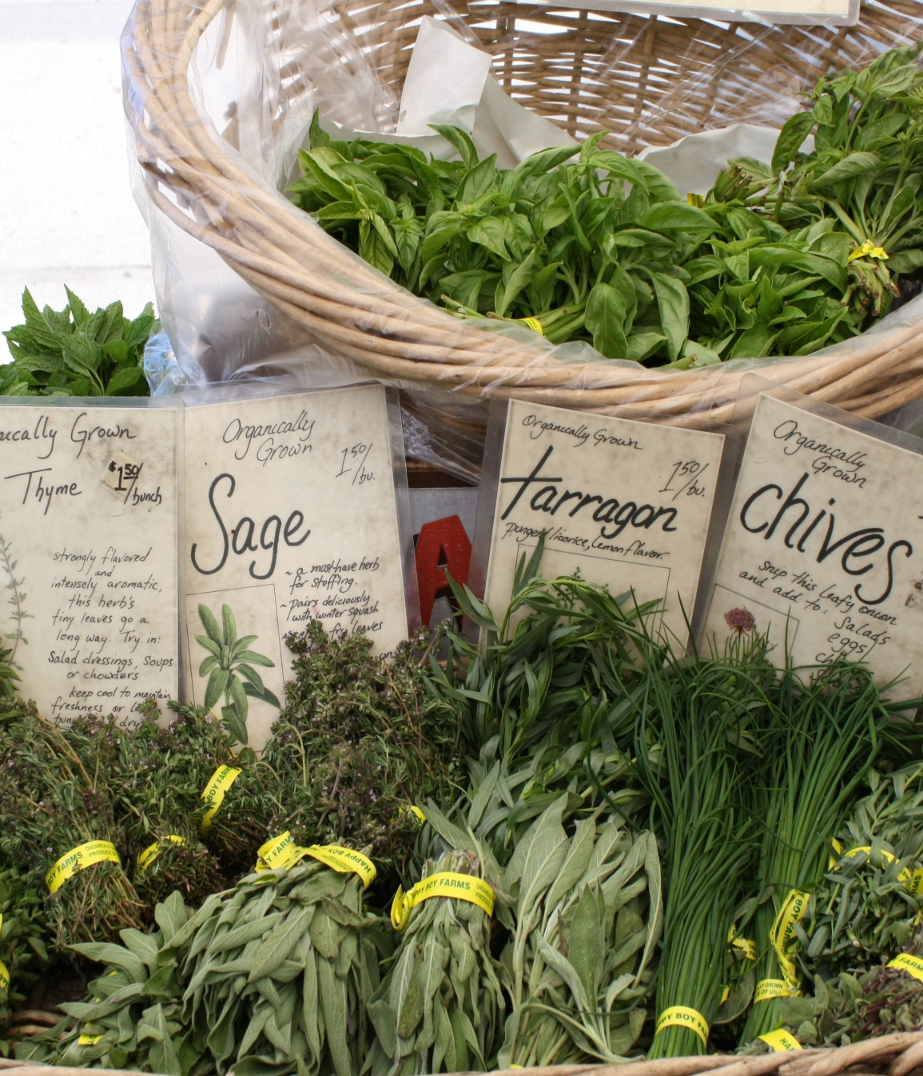
This Not This

Slide 36
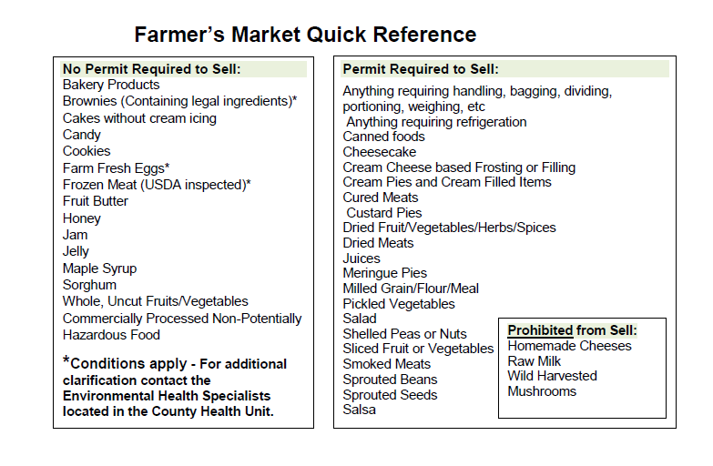
Notes:
This is the back of the handout - reference for everything just covered on cottage foods.

Slide 37
Wear a name tag and a smile.
Notes:
Will be more on marketing in another session . . . Just introduce these critical concepts . . .

Slide 38
Leave the newspaper at home . . .
Talk on your phone some other time!

Slide 39
Be approachable . . . Build relationships ➔ Customer loyalty!

Slide 40
Appearance matters. . .
Create a display that sells itself!

Slide 41
Quality matters . . .
Bring only your best to market!

Slide 42
Create a sense of abundance . . .
Pile it high and kiss it goodbye!

Slide 43
Make your table memorable! Prices easy to read!
Notes:
Signage easy to read from a distance !

Slide 44
Price your product fairly . . .
Don’t be the cheapest and don’t undercut . . .
Don’t drop your prices at the end of the day.

Slide 45
Take advantage of produce drawings to market yourself!

Slide 47
Be consistent, rain or shine . . .

Slide 48
Don’t leave early, even when sold out!
Put up a “Sold Out” sign or “Come Earlier Next Week”!

Slide 49
Offer cooking suggestions or recipes featuring your produce!

Slide 50
Notes:
Regardless of the markets you participate in . . . take advantage of the free marketing opportunities the market provides!

Slide 51
Facebook

Slide 52
Sales Tax Exempt?
Sales of raw products, including Christmas trees, from the farm, orchard, or garden where the sale is made directly by the producer to the consumer, including sales by the producer to the consumer at farmers’ markets. Act 386 of 1941, Act 458 of 1991, Act 1205 of 2009; Ark. Code Ann. § 26-52-401(18)(A)

Slide 53
Notes:
This summary is in the FM 101 packet.

Slide 54
For produce vendors only
Opportunity to expand your customer base
WIC FMNP training at 5pm session today
Training applicable for all markets that have WIC FMNP
WIC FMNP
Notes:
During training sessions, will have chance to sign up for WIC FMNP for the local markets (Separate training session for WIC FMNP is in tool kit).
Hard copies of applications for both MARKETS and FARMERS are in tool kit with training materials for WIC FMNP.

Slide 55
Follow the rules !
Notes:
Just to recap . . . Rules vary by market but all have them . . .
The Cottage Food and Eggs rules are statewide and summary cards are in their FM 101 packets and on the flash drive.

Slide 56
Notes:
This checklist is in the FM 101 packets and is a quick check for most of items covered above.

Slide 57
Notes:
These tips are also in the FM 101 packets.

Slide 58
Notes:
This guide is in the FM 101 packet. Good resource for anyone involved in a Farmers Market in Arkansas . . . READ IT ALL!

Slide 59
See You at the Markets!
Notes:
Add may want to add a picture from your market or? I took ours out

